Slide 1
Internal presenter notes: What attendees should take away
Formatting Reminders:
15-20 slides maximum
Font: Segoe UI, 18pt minimum, 36pt maximum
Code Font: Consolas, 20pt minimum
Include complete speaker notes on every slide
Use the slide options and styles as desired
Remember that we’re building slides for mass public consumption, and any presenter should be able to use them
Presenters are welcome to personalize the presenter slide or make minor adjustments throughout the deck, as long as they convey the main concepts to attendees.

Slide 2
Internal presenter notes: What attendees should take away
Describe Azure Synapse serverless SQL pools
Querying a Data Lake Store using serverless SQL pools in Azure Synapse Analytics
Securing access to data through using serverless SQL pools in Azure Synapse Analytics
Notes:
Welcome to slide deck 5 of 5 of the Azure Synapse Analytics Virtual Training Days
As well as delivering the three items in the slide above, we wanted to use this slide to take the opportunity to share our approach in the creation of this content
Virtual Training Day principles
Virtual Training Day's (VTD) are 5 x 45-minute demo-based sessions that inform the attendees about specific aspects of a technology. They are designed to address a scenario that the technology, or a component of the technology can solve. Due to the limited time, the intention is not to provide deep dive coverage of the content, but to show the art of the possible that will motivate the attendees to find out more information through other channels of learning such as MS Learn or Microsoft Official Curriculum.
Instructional Design principle's
As the intention of this content is to provide information on how a technology can work against a specific scenario in such a short space of time. The instructional design principle for the Azure Synapse Analytics Virtual Training day is to place most of the focus on letting the product shine through demo's. Therefore, the decision has been made that approximately 20 - 30% of the delivery is the slides in this deck, with 70% - 80% based on the demo.
How best to prepare this content
In order to be successful in delivering this content you must thoroughly prepare the following assets:
PowerPoint.
Every PowerPoint slide that has information to the delivery about the technology has presenter notes that outline the talking points for the slide, and also the presenter guidance on how the content could be delivered. That’s not to say that you have to follow the guidance as an experienced presenter, but it may give you some insight into why a slide has been designed in the way it has.
You should be very comfortable with the content in the slides and the notes section, and you should also extensively review the links that have been provided as background information.
Demo’s
You must commit the demo steps to muscle memory, and you should be able to perform the demo’s without looking at instructions to complete them in the time allocated. If you rely on performing a single run through the night before a delivery, your chances of success in the delivery of this content is low.
Azure Synapse Analytics is a very dense product with a broad range of capabilities. As the intention is to showcase the components of the technology to solve common scenarios or issues that customers face, the team performed extensive research with various stakeholders producing content that we hope will resonate with your audience.
The demo document not only provides the instructions on how to perform a technical step; with images, during the demo. There is also an extensive running commentary in the demo steps that explores why you would do something, or how it works. Sometimes you may find a technical instruction in the demo document may only be one line, but there may be a paragraph that follows that explains why that step was taken.
Demo setup
As Azure Synapse Analytics is a very dense product, the setup for the demos takes 3.5- 4 hours. The actual setup steps you take account for about 30 minutes of your time, but there is one setup script that takes approximately 3 hours to run. Not only does this script involve provisioning the services to support the demo, but also the data that will be used in the demo too. Why? As an example, the demo is deck one provide an introduction of the entire product with the demo running through of all the active component of Azure Synapse Analytics.
Roadmap information:
Note that some component of Azure Synapse Analytics is still in preview, so our roadmap includes the following changes and improvement in the future
To update the content as the product evolves
To look at ways of improving the setup process through a more targeted setup
Conversion of demo steps as exercises on the MS Learn platform.

Slide 3
Run interactive queries using
Azure Synapse serverless SQL pools
Speaker name
Notes:
TALKING POINTS
Let’s go over how you can interactively browse data within your data lake un a secure way
PRESENTER NOTES AND GUIDANCE

Slide 4
Agenda
Describe Azure Synapse serverless SQL pools
Querying a data lake store using serverless SQL pools in Azure Synapse Analytics
Securing access to data through using serverless SQL pools in Azure Synapse Analytics
Notes:
TALKING POINTS
Let’s set an agenda for today’s presentation in which we are going to discuss the following:
Describe Azure Synapse serverless SQL pools
Querying a data lake store using serverless SQL pools in Azure Synapse Analytics
Securing access to data through using serverless SQL pools in Azure Synapse Analytics
PRESENTER NOTES AND GUIDANCE
Don’t take too much time in order to present the agenda. Make the points in the topics.

Slide 5
Describe Azure Synapse serverless SQL pools
Notes:
TALKING POINTS
Let’s go over what Azure Synapse serverless SQL pools is. How many of you have the need to explore data, or perform ad hoc transformation?
PRESENTER NOTES AND GUIDANCE
Poll your audience.

Slide 6
Azure Synapse serverless SQL Pools
Every Azure Synapse Analytics workspace comes with serverless SQL pool endpoints so you can start querying data in seconds to minutes in a data lake as soon as the workspace is created. There's no infrastructure to setup or clusters to maintain.
Notes:
TALKING POINTS
Every Azure Synapse Analytics workspace comes with serverless SQL pool endpoints that you can use to query data in the lake.
Serverless SQL pool is a query service over the data in your data lake. It enables you to access your data through the following functionalities:
A familiar T-SQL syntax to query data in place without the need to copy or load data into a specialized store.
Integrated connectivity via the T-SQL interface that offers a wide range of business intelligence and ad-hoc querying tools, including the most popular drivers.
Serverless SQL pool is a distributed data processing system, built for large-scale data and computational functions. Serverless SQL pool enables you to analyze your Big Data in seconds to minutes, depending on the workload. Thanks to built-in query execution fault-tolerance, the system provides high reliability and success rates even for long-running queries involving large data sets.
Serverless SQL pool is serverless, hence there's no infrastructure to setup or clusters to maintain. A default endpoint for this service is provided within every Azure Synapse workspace, so you can start querying data as soon as the workspace is created.
There is no charge for resources reserved, you are only being charged for the data processed by queries you run, hence this model is a true pay-per-use model.
If you use Apache Spark for Azure Synapse in your data pipeline, for data preparation, cleansing or enrichment, you can query external Spark tables you've created in the process, directly from serverless SQL pool. Use Private Link to bring your serverless SQL pool endpoint into your managed workspace VNet.
PRESENTER NOTES AND GUIDANCE
Review the following page for introductory information:
Serverless SQL pool - Azure Synapse Analytics | Microsoft Docs

Slide 7
Comparing dedicated SQL Pools with serverless SQL pools in Azure Synapse Analytics
Dedicated SQL pools
Serverless SQL pools
Used for Data Warehouse operations
Provides predictable performance and costs
Reserves processing power for data stored in SQL tables
Used for data preparation or ad-hoc queries against unstructured data.
Provides an always available SQL endpoint for unplanned workloads
Enables interactive querying
Notes:
TALKING POINTS
Synapse SQL offers both serverless and dedicated resource models, offering consumption and billing options to fit your needs. For predictable performance and cost, provision pools to reserve processing power for data stored in SQL tables. For unplanned or bursty workloads, use the serverless, always-available SQL endpoint.
PRESENTER NOTES AND GUIDANCE
Review:
What is Azure Synapse Analytics:
https://docs.microsoft.com/en-us/azure/synapse-analytics/overview-what-is

Slide 8
Querying a data lake store using serverless SQL pools in Azure Synapse Analytics
Ensure Built-in is selected (1) in the Connect to dropdown list above the query window, then run the query (2). Data is loaded by the serverless SQL endpoint and processed as if was coming from any regular relational database.
Notes:
Talking Points:
Let’s look at how you can query the common files that are stored in an Azure Data Lake

Slide 9
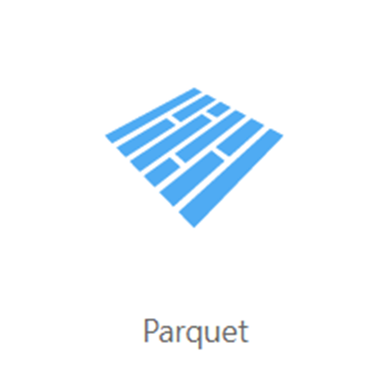
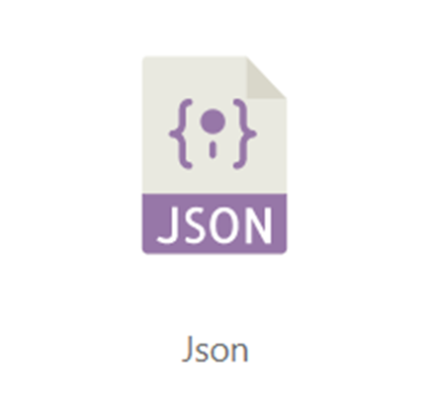
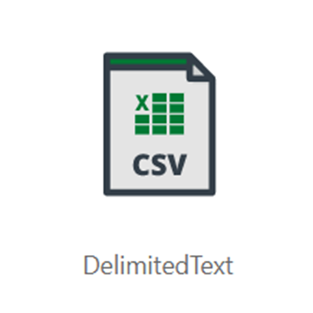
Common files to query
Notes:
TALKING POINTS
Serverless SQL pool enables you to query data in your data lake. It offers a T-SQL query surface area that accommodates semi-structured and unstructured data queries. For querying, the following T-SQL aspects are supported:
- Full SELECT surface area, including majority of SQL functions and operators.
- CREATE EXTERNAL TABLE AS SELECT (CETAS) creates an external table and then exports, in parallel, the results of a Transact-SQL SELECT statement to Azure Storage.
To support a smooth experience for in place querying of data that's located in Azure Storage files, serverless SQL pool uses the OPENROWSET function with additional capabilities:
- Query multiple files or folders
- PARQUET file format
- Query CSV and delimited text (field terminator, row terminator, escape char)
- Read a chosen subset of columns
- Schema inference
- filename function
- filepath function
- Work with complex types and nested or repeated data structures
Full details can be explored here:
Query data storage with serverless SQL pool (preview) - Azure Synapse Analytics | Microsoft Docs

Slide 10
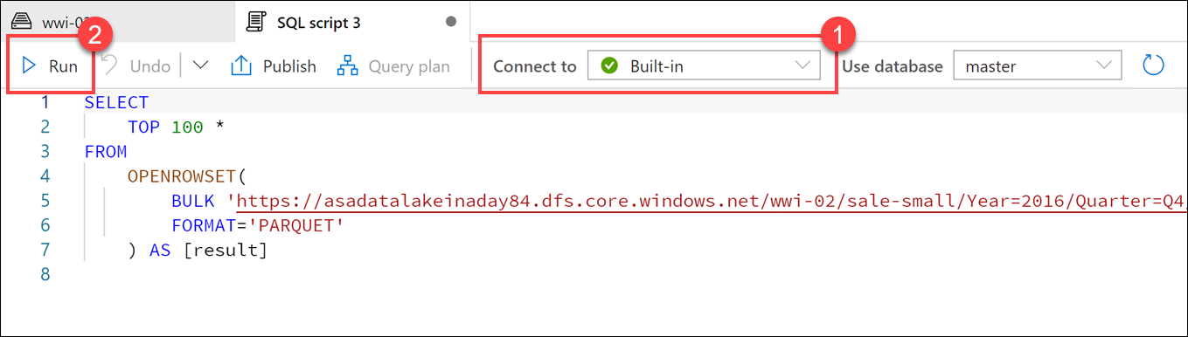
Querying parquet files in a data lake
Notes:
TALKING POINTS
Understanding data through data exploration is one of the core challenges faced today by data engineers and data scientists as well. Depending on the underlying structure of the data as well as the specific requirements of the exploration process, different data processing engines will offer varying degrees of performance, complexity, and flexibility.
In Azure Synapse Analytics, you can use either SQL, Apache Spark for Synapse, or both. Which service you use mostly depends on your personal preference and expertise. When conducting data engineering tasks, both options can be equally valid in many cases. However, there are certain situations where harnessing the power of Apache Spark can help you overcome problems with the source data. This is because in a Synapse
Notebook, you can import from a large number of free libraries that add functionality to your environment when working with data. There are other situations where it is much more convenient and faster using serverless SQL pool to explore the data, or to expose data in the data lake through a SQL view that can be accessed from external tools, like Power BI.
- In Synapse Studio, navigate to the Data hub.
- Select the Linked tab and expand Azure Data Lake Storage Gen2. Expand the primary ADLS Gen2 account and select the container. Navigate to the folder, and right-click on the parquet file, select New SQL script, then Select TOP 100 rows.
- As per the screenshot in the slide, Ensure Built-in is selected (1) in the Connect to dropdown list above the query window, then run the query (2). Data is loaded by the serverless SQL endpoint and processed as if was coming from any regular relational database.

Slide 11
Securing access to data through using SQL serverless in Azure Synapse Analytics
Notes:
Talking Points:
Now that you know what is involved with configuring a HTAP process using Synapse Analytics and Cosmos DB, let’s look into querying some of the data using Apache Spark.
* Query and transform JSON data with Synapse Spark
* Flatten array column with explode function
* Group, order, and apply aggregates
https://github.com/solliancenet/azure-synapse-analytics-workshop-400/blob/master/day-01/lab01-data-integration-part-1.md#task-3-query-user-profile-json-data-with-azure-synapse-spark

Slide 12

Securing access to data in a data lake when using Azure Synapse Analytics
Authentication
Authorization
Encryption
Notes:
Talking Points:
There are 3 areas of security to be aware of with Azure Synapse SQL pools
Authentication is the process of proving the user is who they claim to be. A user connects to a database using a user account. When a user attempts to connect to a database, they provide a user account and authentication information. The user is authenticated using one of the following two authentication methods:
SQL authentication.
With this authentication method, the user submits a user account name and associated password to establish a connection. This password is stored in the master database for user accounts linked to a login or stored in the database containing the user accounts not linked to a login.
Azure Active Directory Authentication
With this authentication method, the user submits a user account name and requests that the service use the credential information stored in Azure Active Directory (Azure AD).
Logins and users: A user account in a database can be associated with a login that is stored in the master database or can be a user name that is stored in an individual database.
A login is an individual account in the master database, to which a user account in one or more databases can be linked. With a login, the credential information for the user account is stored with the login.
A user account is an individual account in any database that may be, but does not have to be, linked to a login. With a user account that is not linked to a login, the credential information is stored with the user account.
Authorization to access data and perform various actions are managed using database roles and explicit permissions. Authorization refers to the permissions assigned to a user, and determines what that user is allowed to do. Authorization is controlled by your user account's database role memberships and object-level permissions. As a best practice, you should grant users the least privileges necessary.
Transparent data encryption (TDE) helps protect Azure Synapse Analytics against the threat of malicious offline activity by encrypting data at rest. TDE must be manually enabled for Azure Synapse Analytics. TDE performs real-time I/O encryption and decryption of the data at the page level. Each page is decrypted when it's read into memory and then encrypted before being written to disk. TDE encrypts the storage of an entire database by using a symmetric key called the Database Encryption Key (DEK). On database startup, the encrypted DEK is decrypted and then used for decryption and re-encryption of the database files in the SQL Server database engine process. DEK is protected by the TDE protector. TDE protector is either a service-managed certificate (service-managed transparent data encryption) or an asymmetric key stored in Azure Key Vault (customer-managed transparent data encryption).

Slide 13
Demo: Run interactive queries using Azure Synapse serverless SQL pools
Speaker name
Notes:
TALKING POINTS​
​
Let’s put this into reality and show you how it works.​
​
All instructions and context are found in this repository​
​
The demo instructions for this section can be found at: https://aka.ms/ctovtd5
The demo setup can be found at the following url: https://aka.ms/ctodesgdeployasyn​
​
​
​

Slide 14
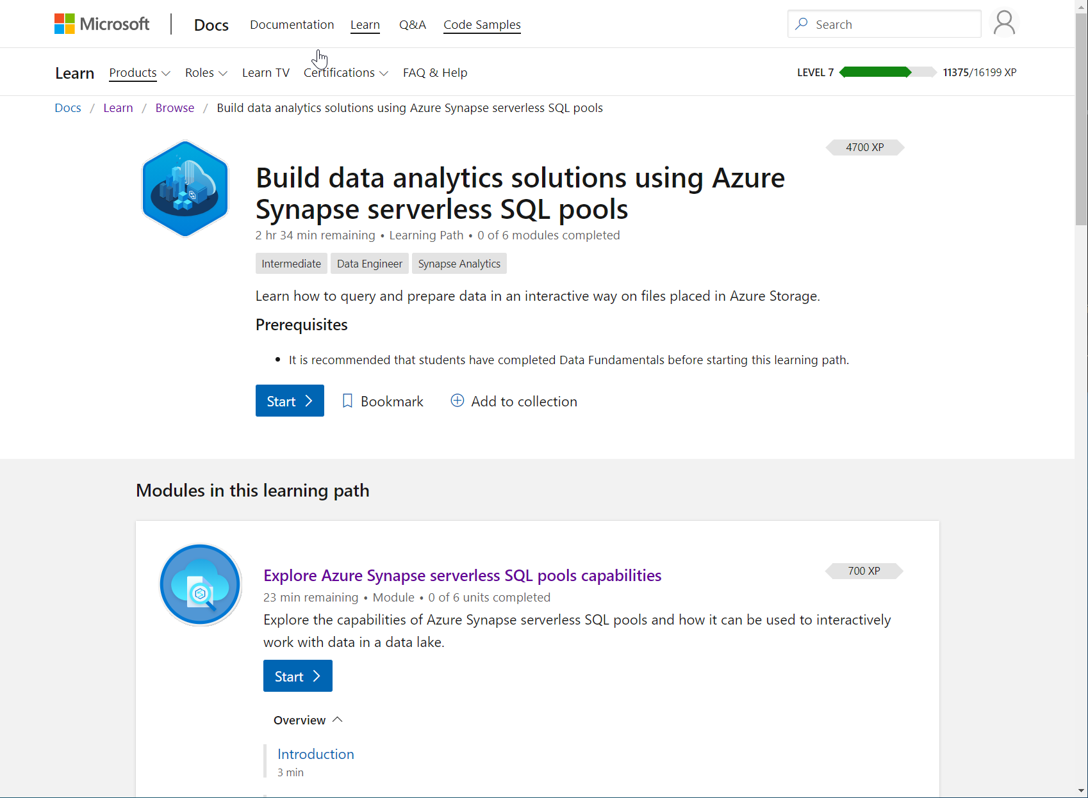
/learn alert
Complete interactive learning exercises, watch videos,
and practice and apply your new skills.
aka.ms/mslearnasaserverless

